Slide 1
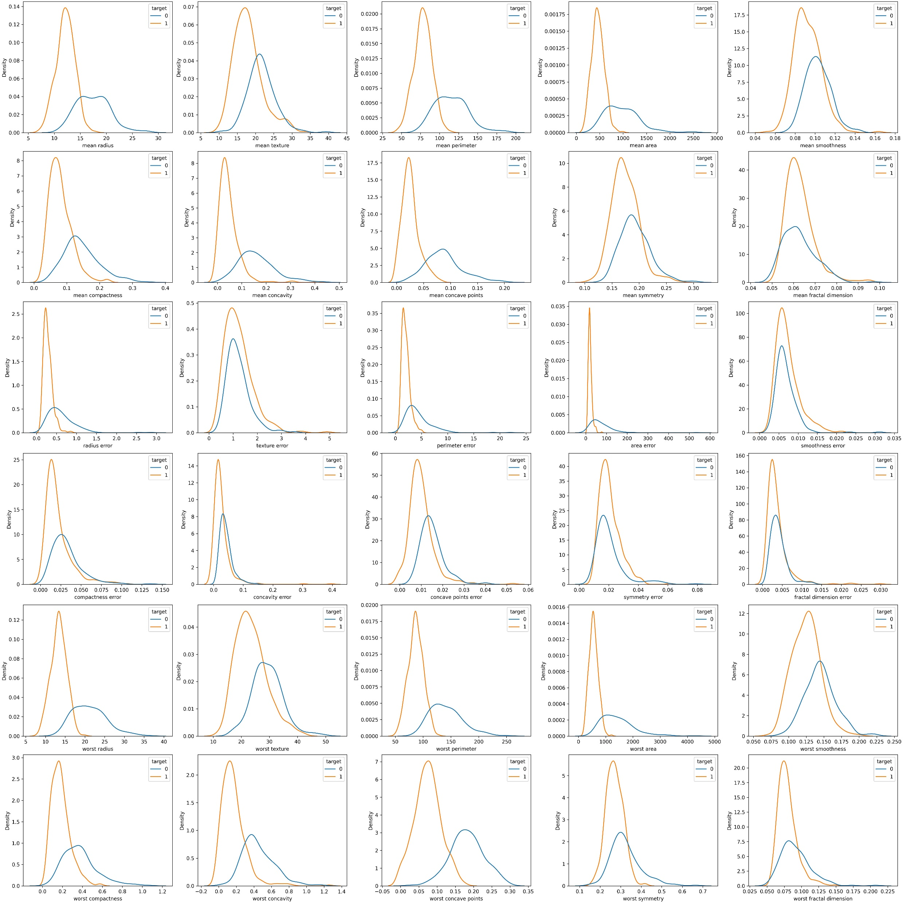
Visual representation of the features regarding the outcome
KDE plots 1

Slide 2
Visual representation of the features regarding the outcome
KDE plots 2

Slide 3
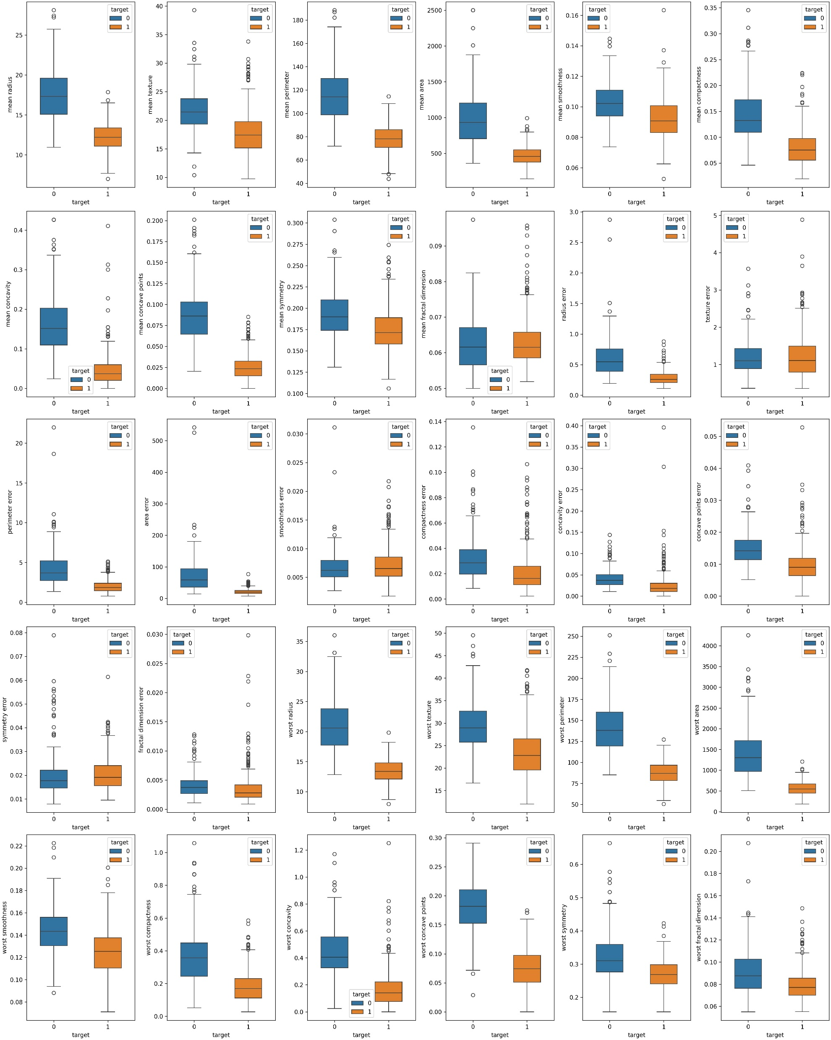
Visual representation of the features regarding the outcome
Box plots 1

Slide 4
Visual representation of the features regarding the outcome
Box plots 2

Slide 5
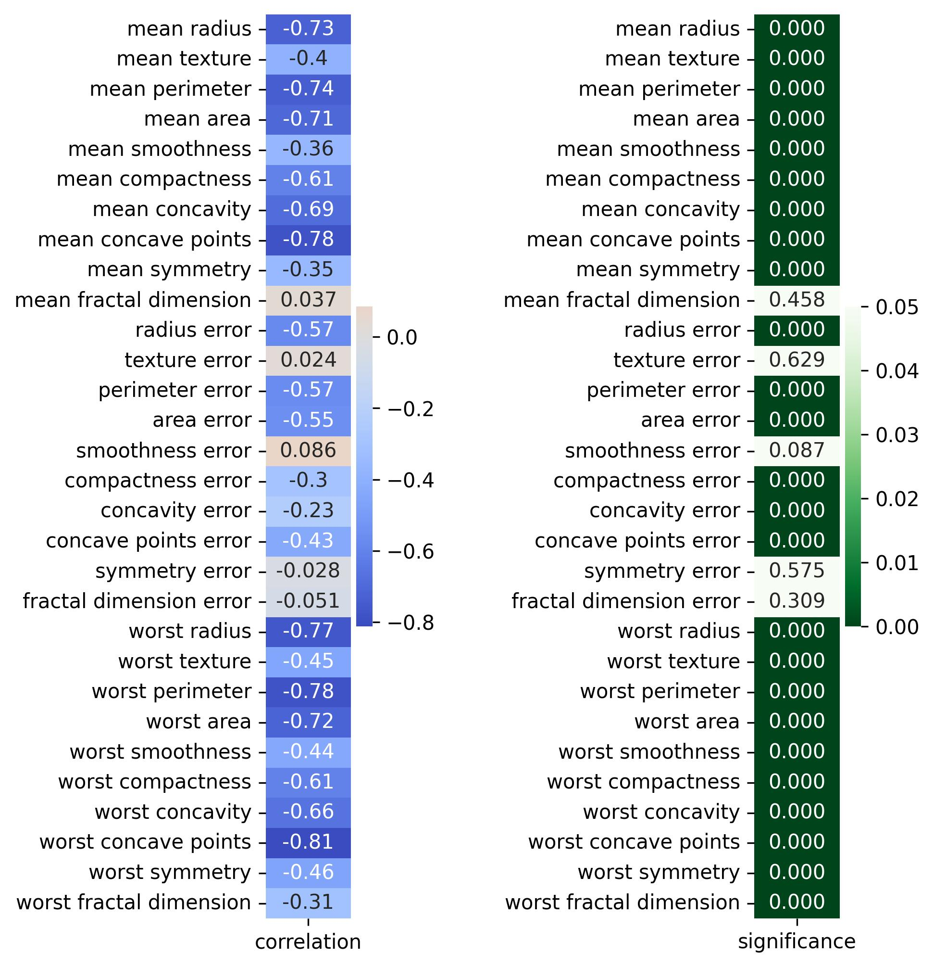
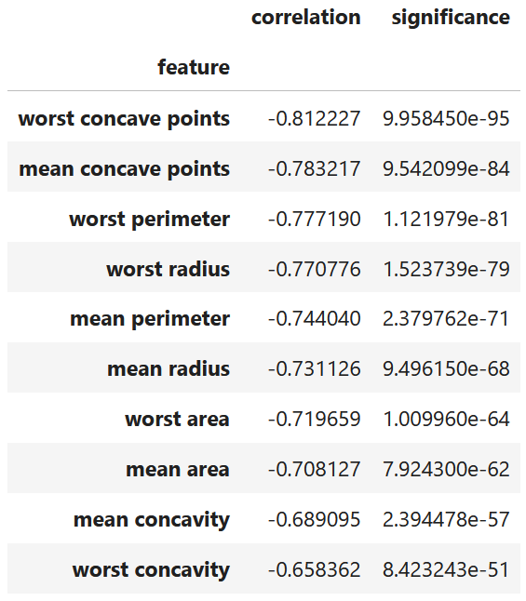
Feature selection - Univariate methods
Correlation analysis: Point-Biserial correlation between each feature and the target
Selected features
(Corr. coefficint > 0.65)

Slide 6
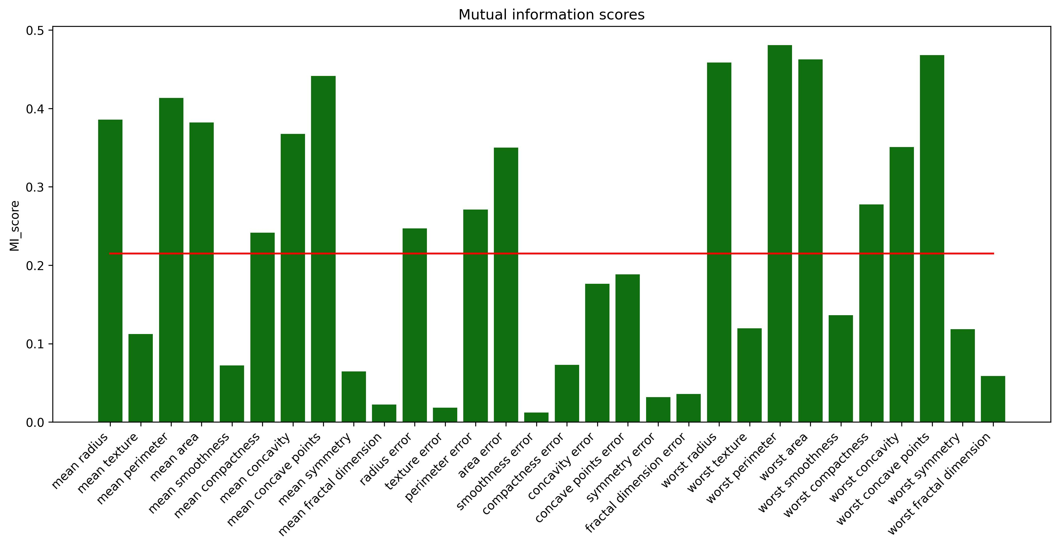
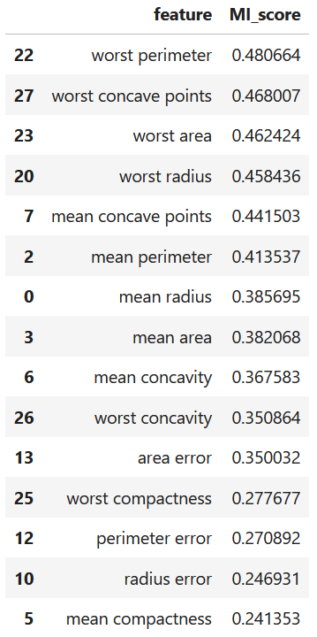
Feature selection - Univariate methods
Mutual information score:
Selected features
(MI score > median)
median

Slide 7
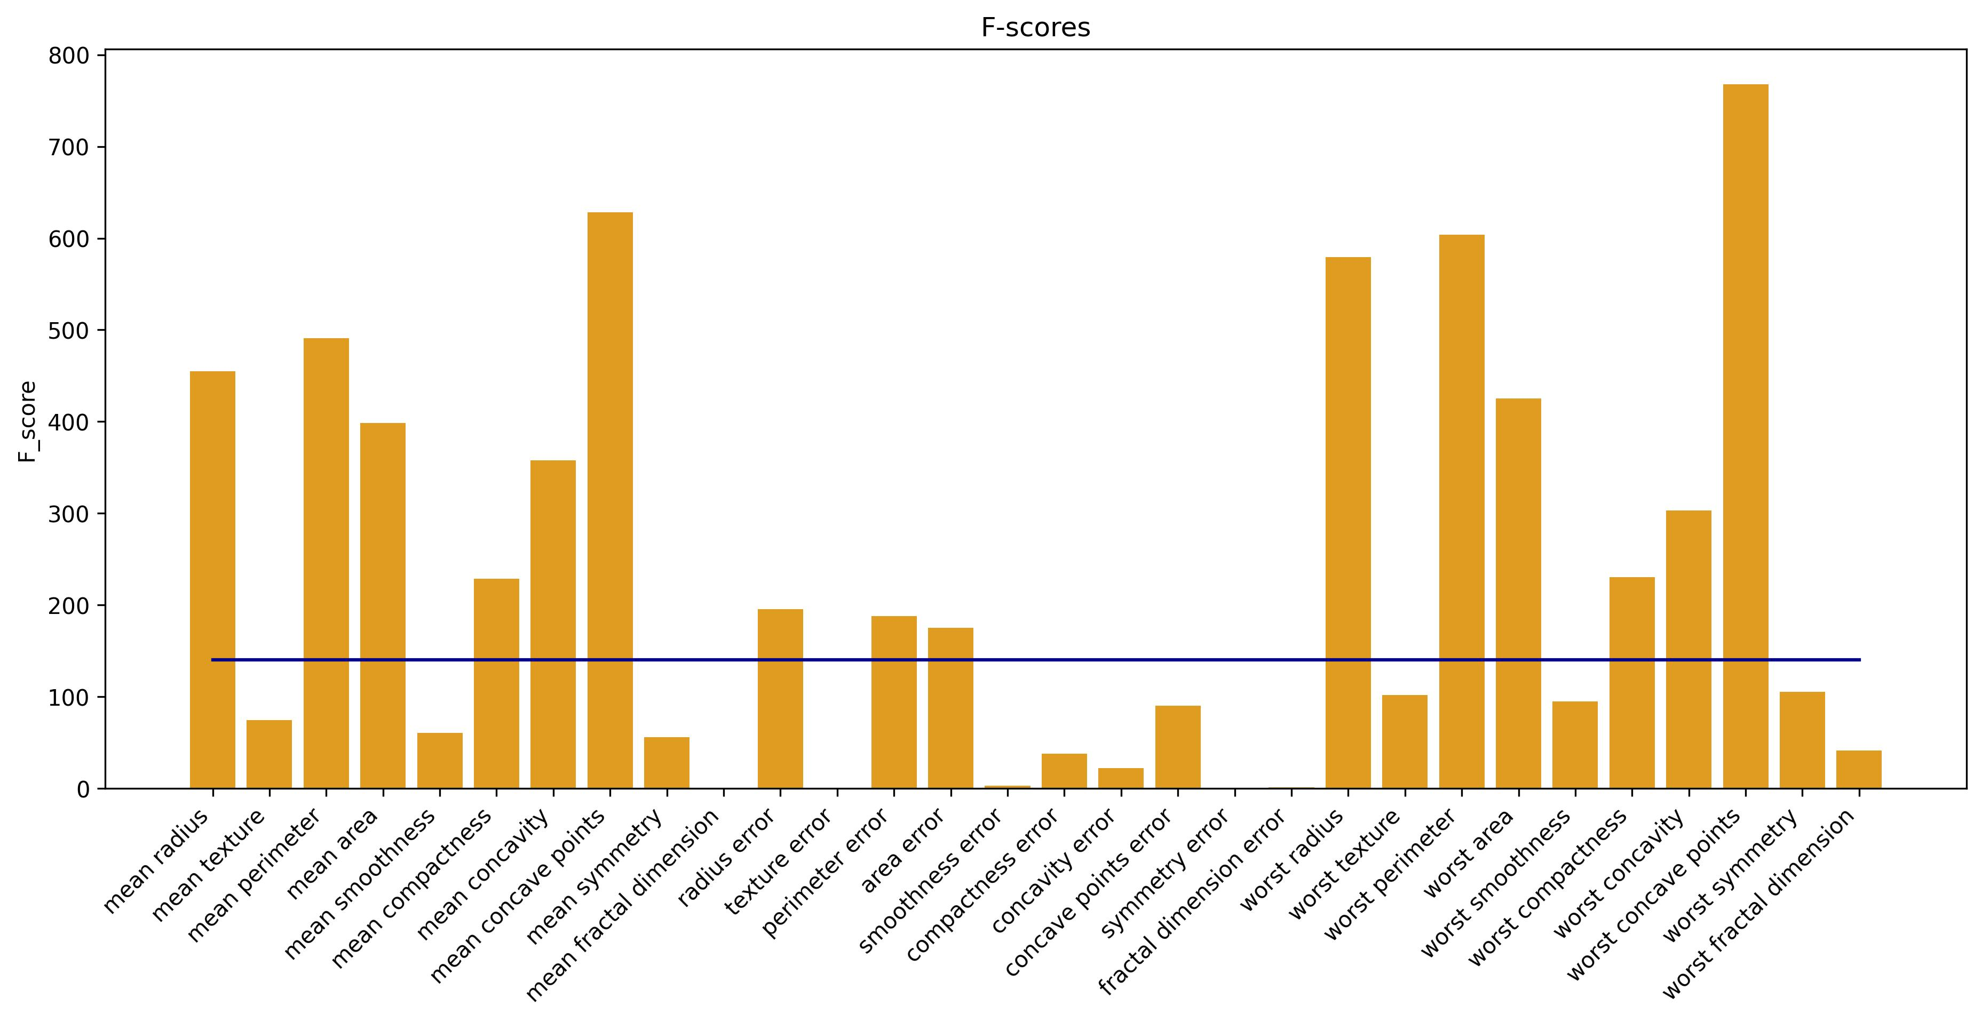
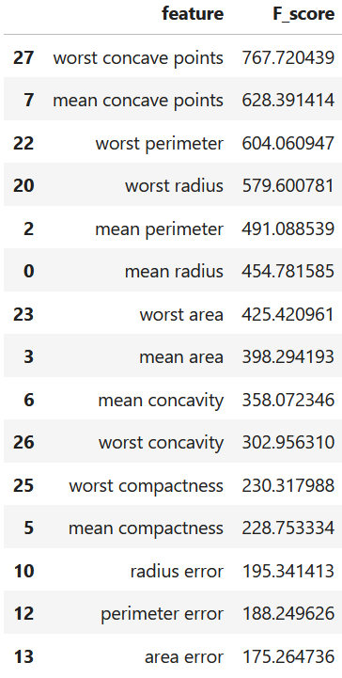
Feature selection - Univariate methods
F-score:
Selected features
(F-score > median)
median

Slide 8
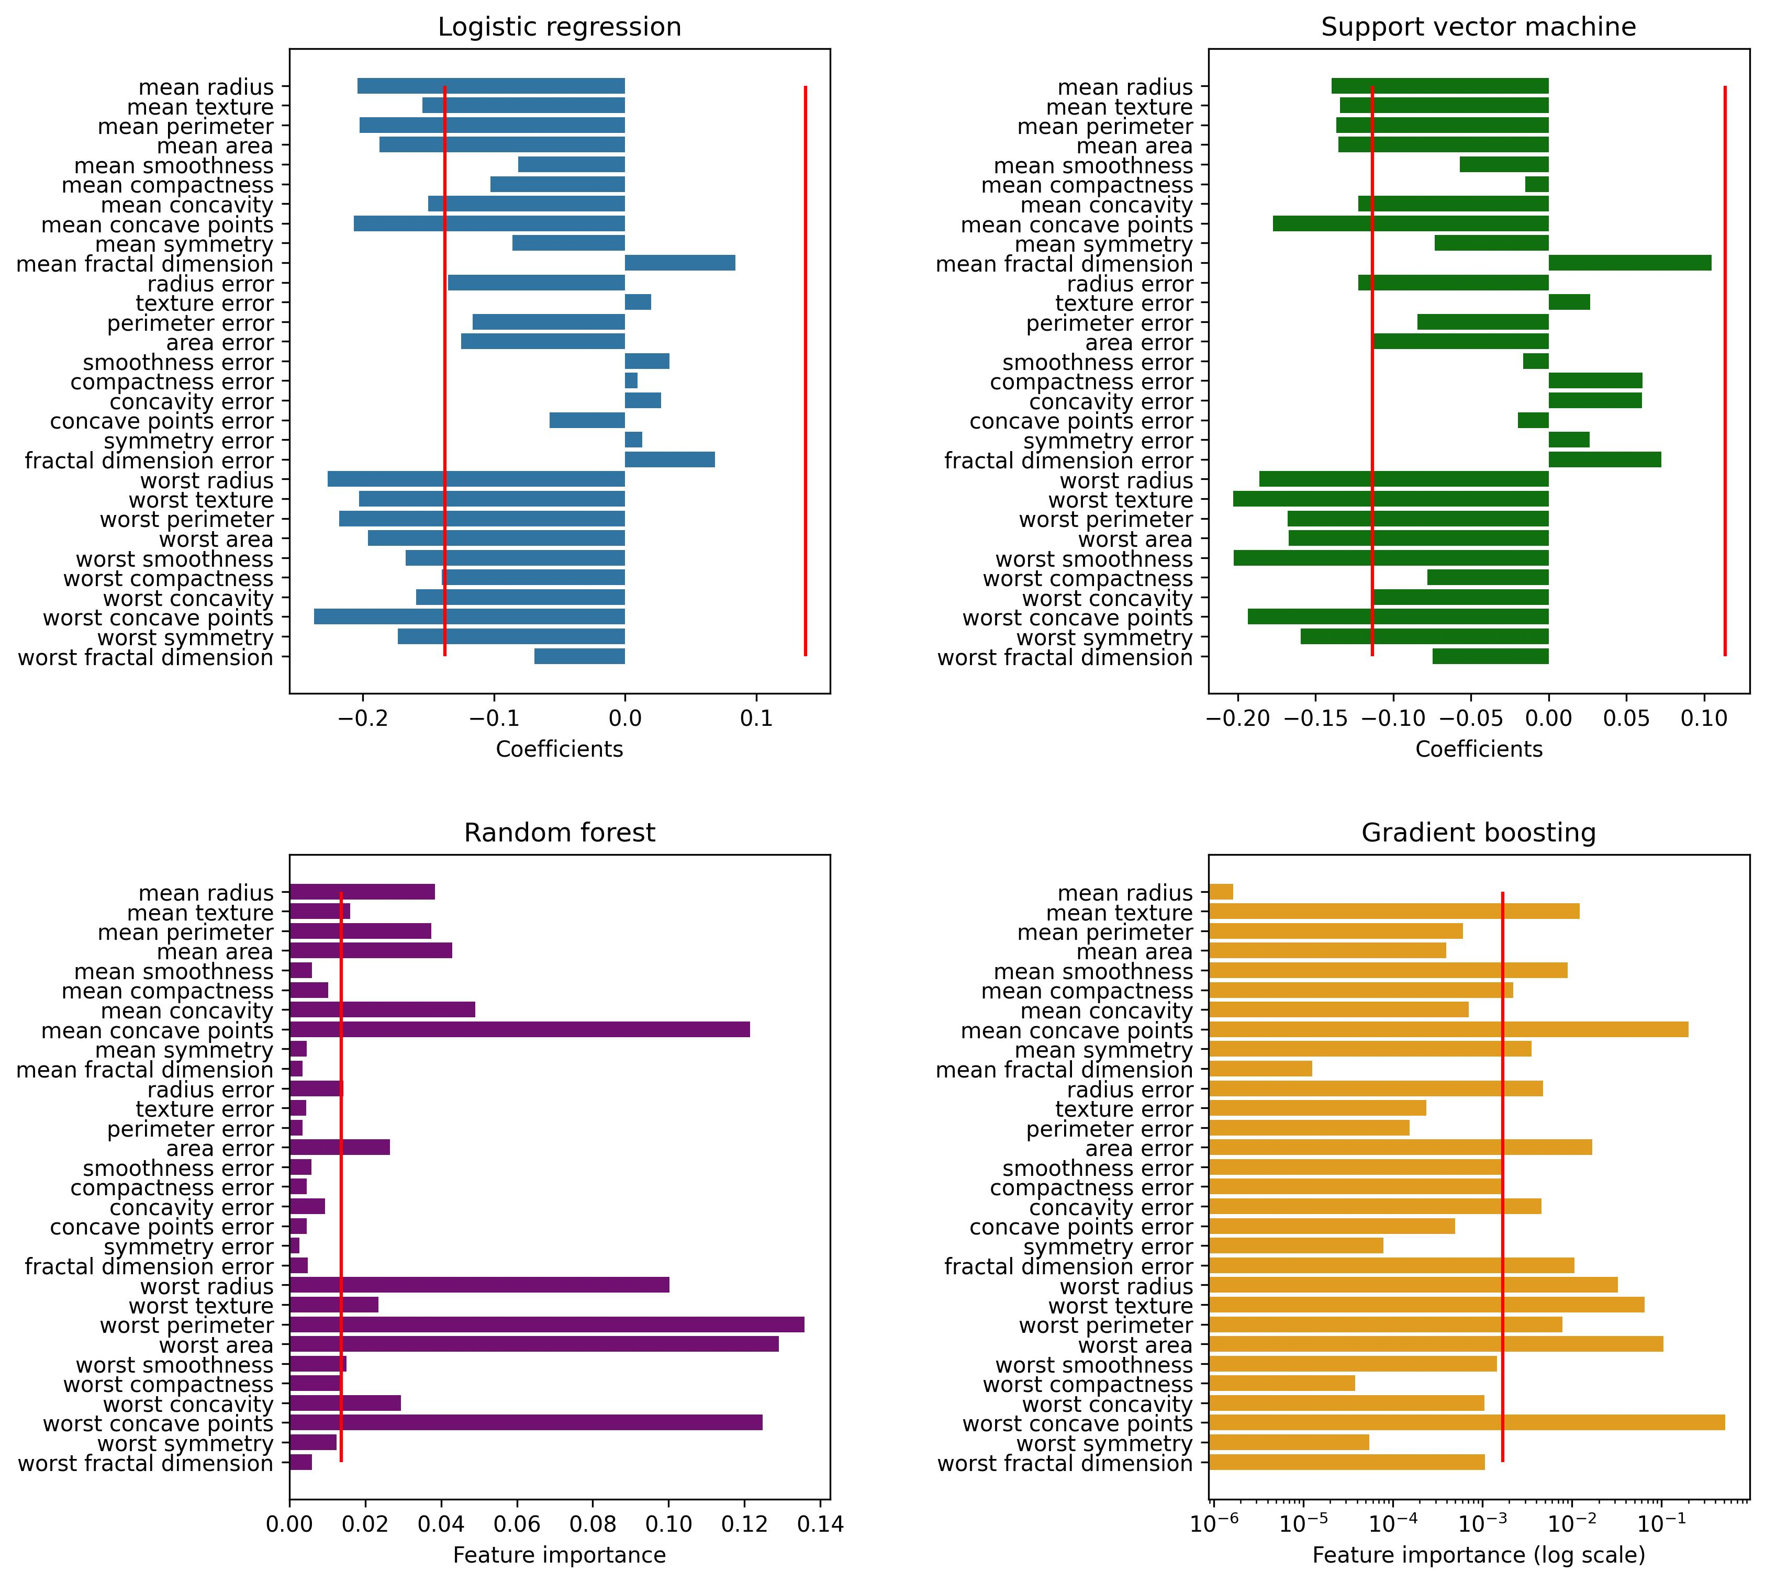
Feature selection - Multivariate methods
The selection is based on feature importance with Select From Model (SFM):
Tested ML models: logistic regression, SVM, random forest and gradient boosting
Selected features: coefficient > median (red lines)

Slide 9
Feature selection - Multivariate methods
The selection is based on feature importance with Select From Model (SFM):
Tested ML models: logistic regression, SVM, random forest and gradient boosting
Selected features: feature importance > median (red lines)

Slide 10
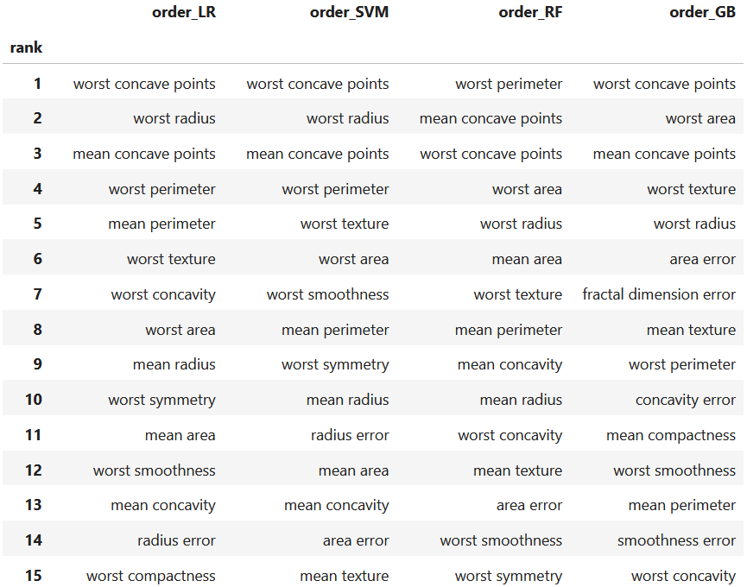
Feature selection - Multivariate methods
Ranking of features with Recursive Feature Elimination (RFE):
Tested ML models: logistic regression, SVM, random forest and gradient boosting
Selected features
(Top 15)

Slide 11
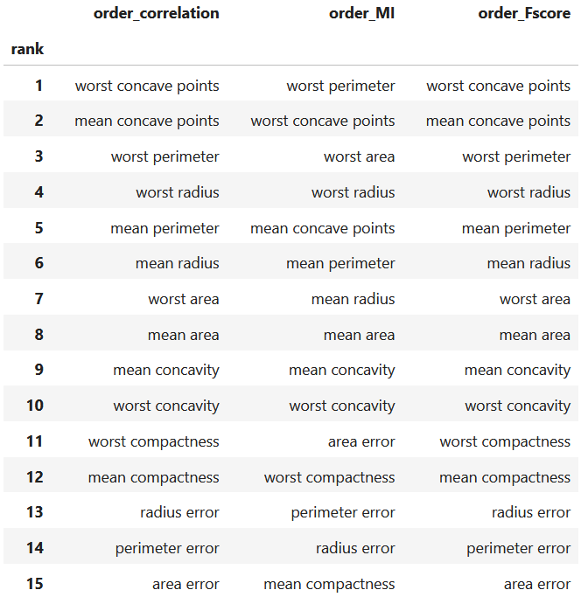
Comparison of uni- and multivariate feature selection by ranking
(Top 15 features)
Univariate
Multivariate (RFE)

Slide 12
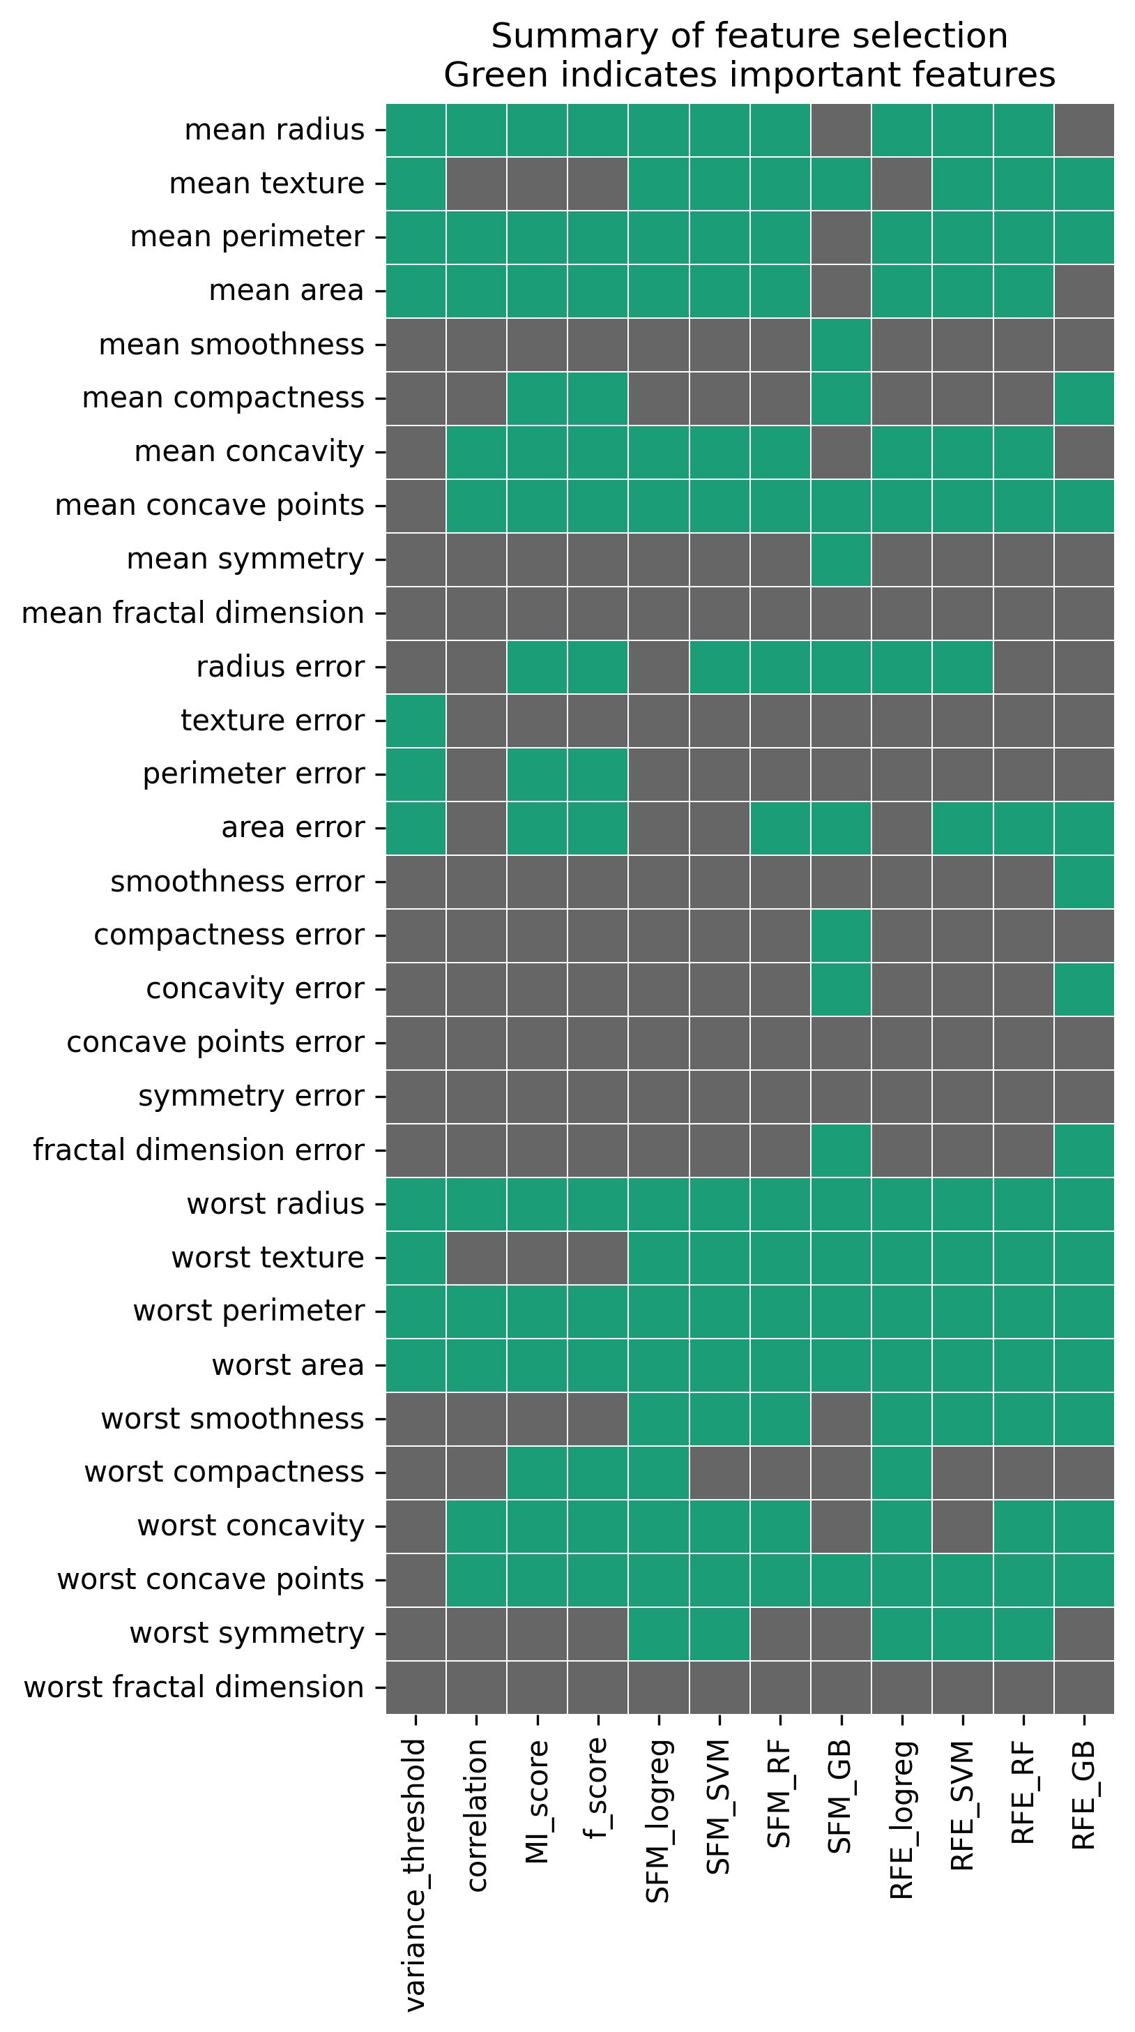
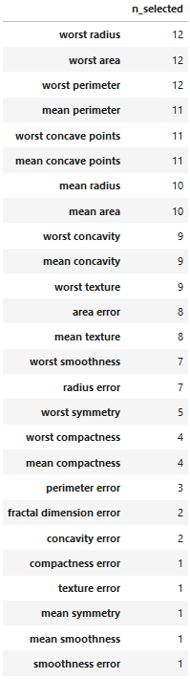
Summary
Final selection of the features
Number of times a feature was selected
Top 10:
worst concave points
worst radius
mean concave points
worst perimeter
mean perimeter
worst texture
worst area
mean radius
worst symmetry
mean area / worst concavity
Only from the worst category:
worst concave points
worst radius
worst perimeter
+
4th: worst texture
5th: worst area
6th: worst concavity
Accounting for multi-collinearity:
worst concave points
worst radius
worst texture
worst concavity

Slide 13
Reasons behind the final selection of features
Error metrics does not seem to be useful, both mean and worst metrics are better, therefore it seems logical to exclude all of them.
Since logistic regression performed the best during the initial testing, I tried to optimize for that and mainly focused on the results of that model from SFM and RFE
10 best predictors: the selection was based on both univariate and multivariate (for logistic regression) methods, with more emphasis on SFM and RFE results. 9 features were consistently selected, however the 10th was questionable and could be either mean area or worst concavity.
To use only one type of metrics for the prediction worst would be the best option. It could reduce computational cost even before the ML pipeline and could save storage space as well.
With this option the 3 best candidates are worst concave points, worst radius and worst perimeter. These 3 features are also in the top 5 with every selection method.
Besides these, the following features could be added to this list based on embedded and univariate methods as well (in the indicated order):
4th worst texture
5th worst area
6th worst concavity
If multi-collinearity is taken into account the selection could be reduced to the following 4 features: worst concave points, worst radius, worst texture, worst concavity.

